Slide 1
[Redacted] Sightings
Group 12: Carmen Doria, Dellaraam Pourkeramati, and Jaskaran Halait

Slide 2
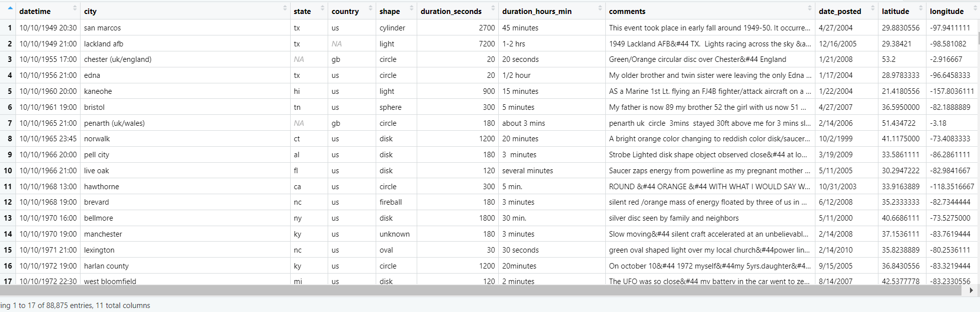
Cleaning Data
Change Chars to Facs and Nums
“NA’s” or gaps in the data
Separate days and years
All plots were generated with this dataset
Notes:
Dellaraam

Slide 3
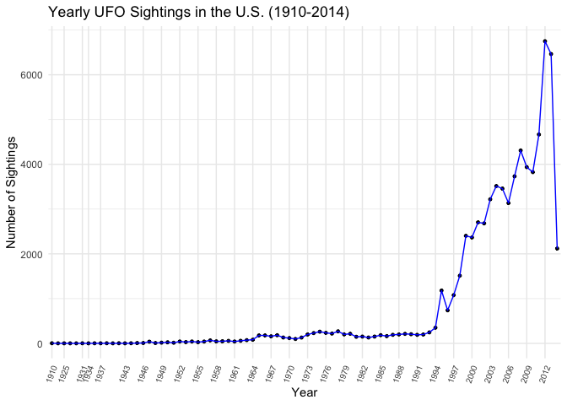
Peak reported sightings in 2012 (6,750)
What could have led to the sudden increase in reported sightings?
End of the world???
Kecksburg and Exeter incidents
Michigan sightings
Roswell
Notes:
Line plot goes here

Slide 4
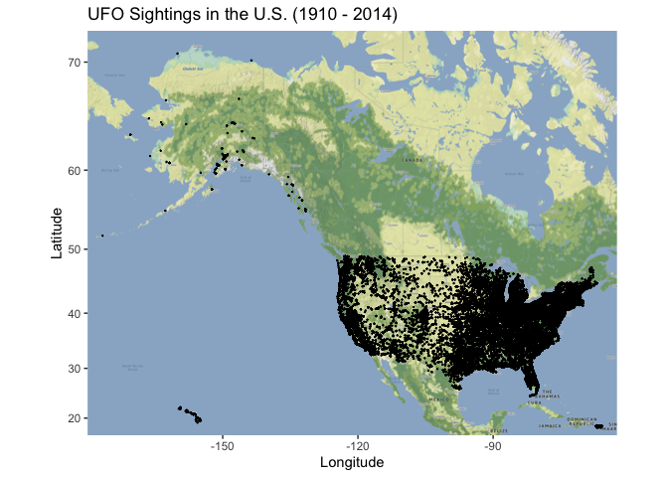
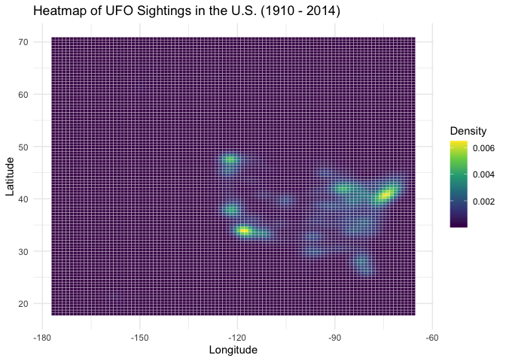
Notes:
Carmen

Slide 5
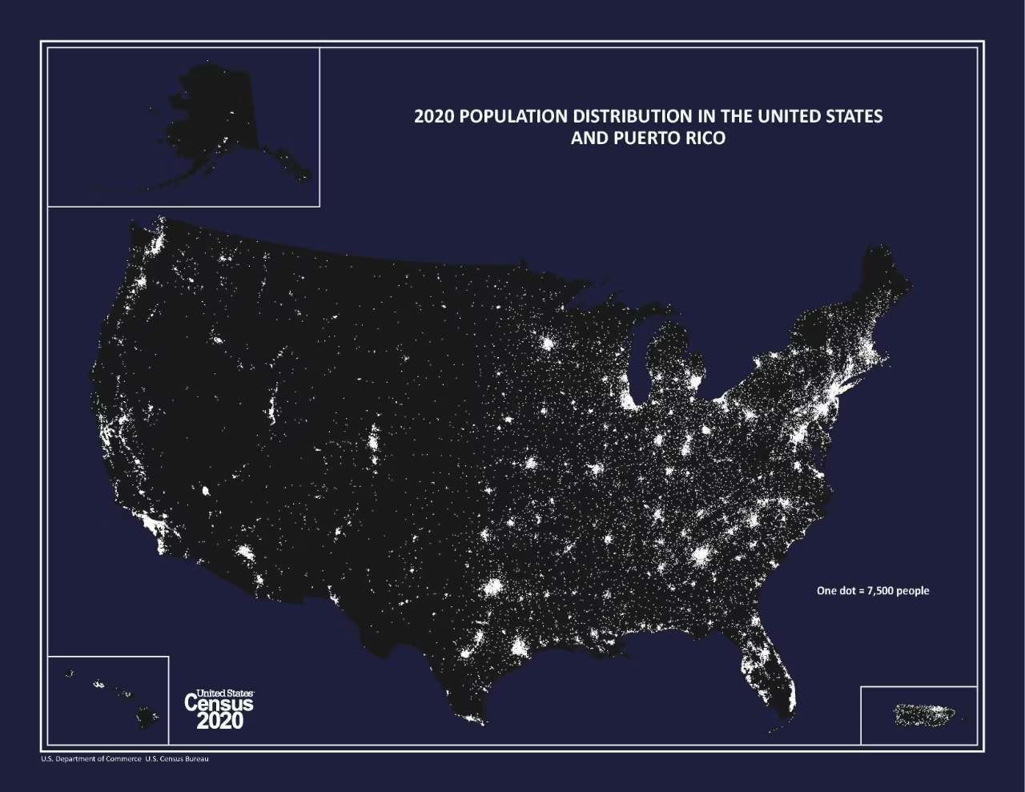
Notes:
Jaski
Photo taken from https://www.census.gov/library/visualizations/2021/geo/population-distribution-2020.html

Slide 6
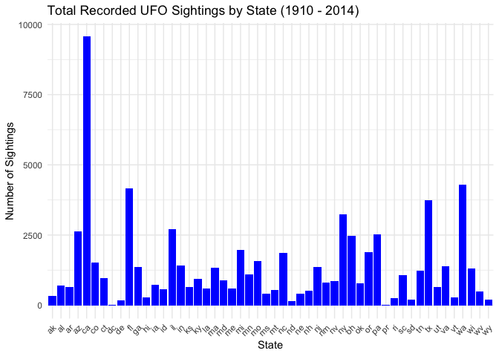
Notes:
Jaski
CA appears to have the largest count of sightings (could be good or bad depending on what you want; maybe they like the weather too)

Slide 7
Thanks!
Any Questions?
U.F.OH No
Dataset obtained from: https://www.kaggle.com/datasets/NUFORC/ufo-sightings

